Slide 1

Weather Analytics Platform

Slide 2
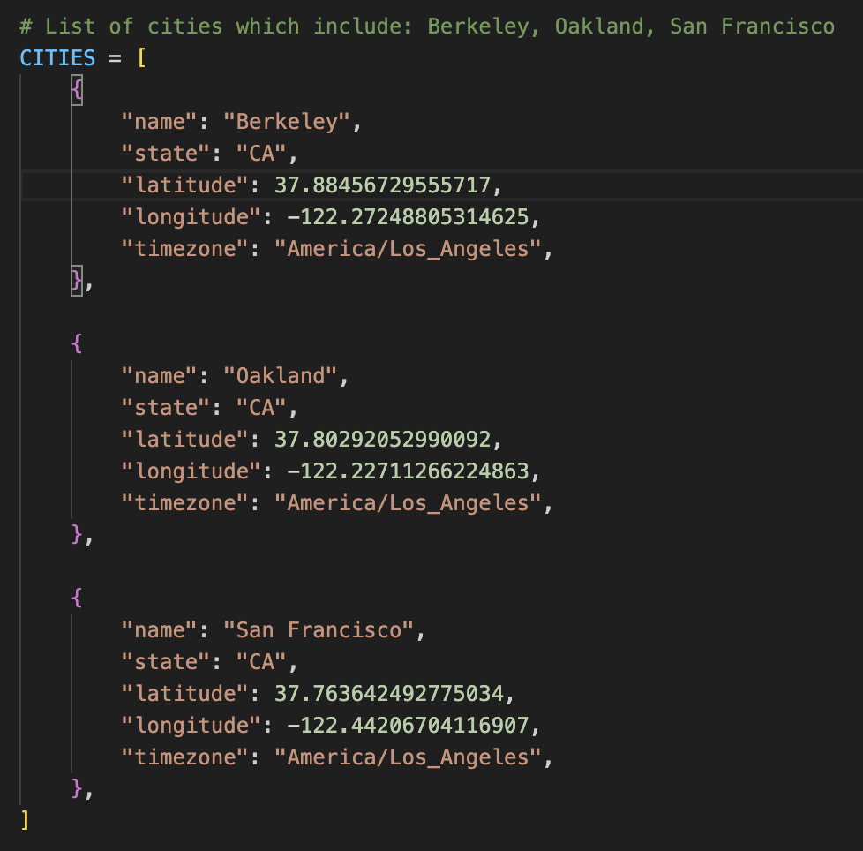
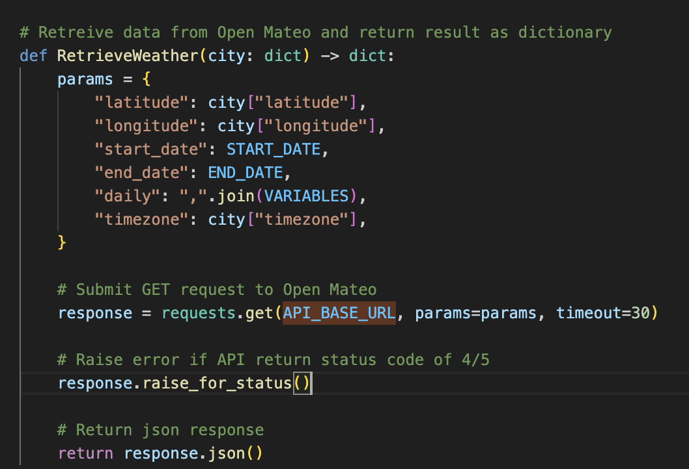
About
Weather Analysis Platform is an application that analyzes the temperatures of Berkeley, Oakland and San Francisco. It operates by importing weather data from an opensource weather service: Open Mateo API weather. Raw data is stored in JSON format located in Data/Raw directory. From there, the raw is imported to data frame to conduct data wrangling operation. During this phase, data wrangling operations include removal of duplicates, filling null values, eliminating negative values, and addressing data inconsistencies (example: min > max). From there, the data is loaded into a Postgres database, allowing user to execute queries for analytical purposes.
Cities include: Berkeley, Oakland & San Francisco
Produces query parameter (params) and then executes get request to retrieve raw data

Slide 3
Codebase
Weather Analysis Platform is an application that imports weather data from an opensource weather service: Open Mateo API weather. Raw data is stored in JSON format located in /Raw directory. From there, the raw is imported to data frame to conduct data wrangling operation. During this phase, data wrangling operations include removal of duplicates, filling null values, eliminating negative values, and addressing data inconsistencies (example: min > max). From there, data is configured
Files | Description
Ingest.py | Calls Open-Mateo API for Berkely, Oakland and San Francisco. Saves raw JSON to Data/Raw directory.
Clean.py | Raw Json data is transferred to data frames. Executes data wrangling operation on data frame for the purpose of revising data. From there, cleaned data is exported to Data/Processed/weather.csv
Database.py | Establishes DB configuration settings by calling GetConnection(), run schema through schema.sql and test connection to ensure application can connecton to PostgreeSQL
Dao.py | Exports weather.csv into Postgres and inserts data frame information into its corresponding tables
main.py | Calls schema file
scehma.sql | Creates cities and weather table using DDL logic
queries.sql | Produces 5 queries: • Hottest day of year per city • Average rainfall • Monthly precipitation • Determine peak wind per week for each city • Frequency of extreme heat days over 86 degree Fahrenheit

Slide 4
Queries
Five SQL queries in `queries.sql` perform operations such as:
• Hottest day of the year per city
• Average rainfall,
• Monthly precipitation,
• Windiest weeks,
• Frequency of extreme heat days over 88 degree Fahrenheit.
-- Query 1: Find the highest temperature per city
SELECT DISTINCT ON (c.city_id)
c.name AS city,
w.record_date,
w.temp_max_c AS “hottest max temp (celsius)”,
ROUND((w.temp_max_c * 9.0 / 5.0) + 32, 2)
AS “hottest max temp (fahrenheit)”
FROM weather w
JOIN cities c ON c.city_id = w.city_id
ORDER BY c.city_id, w.temp_max_c DESC, w.record_date;
-- Determine average rainfall per city
SELECT
c.name AS city,
ROUND(AVG(w.rain_mm), 2) AS average_rain,
ROUND(SUM(w.rain_mm), 2) AS total_rain
FROM weather w
JOIN cities c ON c.city_id = w.city_id
GROUP BY c.name
ORDER BY average_rain DESC;
-- Query 3: Total monthly precipitation by city
SELECT
c.name AS city,
DATE_TRUNC('month', w.record_date)::DATE AS month,
ROUND(SUM(w.rain_mm), 2) AS total_rain,
COUNT(*) AS days_in_month
FROM weather w
JOIN cities c ON c.city_id = w.city_id
GROUP BY c.name, DATE_TRUNC('month', w.record_date)
ORDER BY c.name, month;
-- Query 4: Windiest week of the year per city
SELECT
c.name AS city,
DATE_TRUNC('week', w.record_date)::DATE AS week_start,
ROUND(MAX(w.wind_speed_max_kmh), 2) AS peak_wind_kmh
FROM weather w
JOIN cities c ON c.city_id = w.city_id
GROUP BY c.name, DATE_TRUNC('week', w.record_date)
ORDER BY peak_wind_kmh DESC
LIMIT 5;
-- Query 5: Determine frequency of extreme heat days (max temp >= 86°C)
\echo '--------------- Query 5: Frequency of extreme heat (max temp >= 86°C) ---------------\n'
\echo ''
SELECT
c.name AS city,
COUNT(*) FILTER (WHERE w.temp_max_c >= 30) AS hot_days,
COUNT(*) AS total_days,
ROUND(
100.0 * COUNT(*) FILTER (WHERE w.temp_max_c >= 30) / COUNT(*),
1
) AS "Percentage of hot days"
FROM weather w
JOIN cities c ON c.city_id = w.city_id
GROUP BY c.name
ORDER BY hot_days DESC;

